Slide 1
Chapter 2 Instructions指令
Notes:
MIPS, RISK-V都是RISC精简指令集
X86是CISC是复杂指令集

Slide 2
1 Summary

Slide 3
Category | Instruction | Example | Meaning | Comments
Arithmetic | add | add rd,rs1,rs2 | rd=rs1 + rs2 | Add two source register operands
 | subtract | sub rd,rs1,rs2 | rd=rs1 – rs2 | First source register subtracts second one
 | add immediate | addi x5,x6,20 | x5=x6+20 | Used to add constants
Data transfer | load doubleword | ld x5, 40(x6) | x5=Memory[x6+40] | doubleword from memory to register
 | store doubleword | sd x5, 40(x6) | Memory[x6+40]=x5 | doubleword from register to memory
 | load word | lw x5, 40(x6) | x5=Memory[x6+40] | word from memory to register
 | load word, unsigned | lwu x5, 40(x6) | x5=Memory[x6+40] | Unsigned word from memory to register
 | store word | sw x5, 40(x6) | Memory[x6+40]=x5 | word from register to memory
 | load halfword | lh x5, 40(x6) | x5=Memory[x6+40] | Halfword from memory to register
除了load类型之外，都是目的
寄存器rs在最前面
Category | Instruction | Example | Meaning | Comments
Data transfer | load halfword, unsigned | lhu x5, 40(x6) | x5=Memory[x6+40] | Unsigned halfword from memory to register
 | store halfword | sh x5, 40(x6) | Memory[x6+40]=x5 | halfword from register to memory
 | load byte | lb x5, 40(x6) | x5=Memory[x6+40] | byte from memory to register
 | load word, unsigned | lbu x5, 40(x6) | x5=Memory[x6+40] | Unsigned byte from memory to register
 | store byte | sb x5, 40(x6) | Memory[x6+40]=x5 | byte from register to memory
 | load reserved | lr.d x5,(x6) | x5=Memory[x6] | Load;1st half of atomic swap
 | store conditional | sc.d x7,x5,(x6) | Memory[x6]=x5; x7 = 0/1 | Store;2nd half of atomic swap
 | Load upper immediate | lui x5,0x12345 | x5=0x12345000 | Loads 20-bits constant shifted left 12 bits

Slide 4
Category | Instruction | Example | Meaning | Comments
Logical | and | and x5, x6, 3 | x5=x6 & 3 | Arithmetic shift right by register
 | inclusive or | or x5,x6,x7 | x5=x6 | x7 | Bit-by-bit OR
 | exclusive or | xor x5,x6,x7 | x5=x6 ^ x7 | Bit-by-bit XOR
 | and immediate | andi x5,x6,20 | x5=x6 & 20 | Bit-by-bit AND reg. with constant
 | inclusive or immediate | ori x5,x6,20 | x5=x6 | 20 | Bit-by-bit OR reg. with constant
 | exclusive or immediate | xori x5,x6,20 | X5=x6 ^ 20 | Bit-by-bit XOR reg. with constant
Shift | shift left logical | sll x5, x6, x7 | x5=x6 << x7 | Shift left by register
 | shift right logical | srl x5, x6, x7 | x5=x6 >> x7 | Shift right by register
 | shift right arithmetic | sra x5, x6, x7 | x5=x6 >> x7 | Arithmetic shift right by register
 | shift left logical immediate | slli x5, x6, 3 | x5=x6 << 3 | Shift left by immediate
Category | Instruction | Example | Meaning | Comments
Shift | shift right logical immediate | srli x5,x6,3 | x5=x6 >> 3 | Shift right by immediate
 | shift right arithmetic immediate | srai x5,x6,3 | x5=x6 >> 3 | Arithmetic shift right by immediate
Conditional branch | branch if equal | beq x5, x6, 100 | if(x5 == x6) go to PC+100 | PC-relative branch if registers equal
 | branch if not equal | bne x5, x6, 100 | if(x5 != x6) go to PC+100 | PC-relative branch if registers not equal
 | branch if less than | blt x5, x6, 100 | if(x5 < x6) go to PC+100 | PC-relative branch if registers less
 | branch if greater or equal | bge x5, x6, 100 | if(x5 >= x6) go to PC+100 | PC-relative branch if registers greater or equal
 | branch if less, unsigned | bltu x5, x6, 100 | if(x5 >= x6) go to PC+100 | PC-relative branch if registers less, unsigned
 | branch if greater or equal, unsigned | bgeu x5, x6, 100 | if(x5 >= x6) go to PC+100 | PC-relative branch if registers greater or equal, unsigned
Category | Instruction | Example | Meaning | Comments
Unconditional branch | jump and link | jal x1, 100 | x1 = PC + 4; go to PC+100 | PC-relative procedure call
 | jump and link register | jalr x1, 100(x5) | x1 = PC + 4; go to x5+100 | procedure return; indirect call

Slide 5
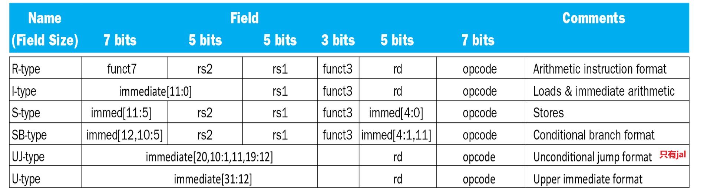

Slide 6
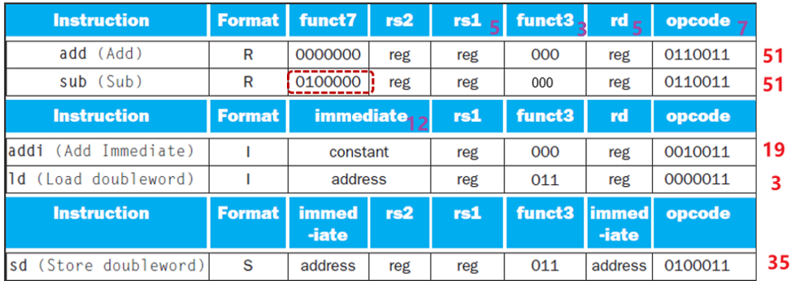
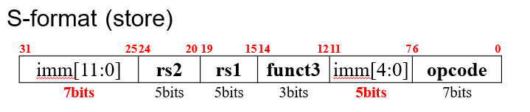
R-, I-, S-type instruction format
有addi, 没有subi, 因为immediate字段表示的是二进制补码整数，所以addi可以用来做减法。
sd rs2, imm(rs1)

Slide 7
Example 1
Name | Format | Example |  |  |  |  |  | Comment
add | R | 0 | 3 | 2 | 0 | 1 | 51 | add x1, x2, x3
sub | R | 32 | 3 | 2 | 0 | 1 | 51 | sub x1, x2, x3
addi | I | 1000 |  | 2 | 0 | 1 | 19 | addi x1,x2,1000
ld | I | 1000 |  | 2 | 3 | 1 | 3 | ld x1, 1000(x2)
sd | S | 31 | 1 | 2 | 3 | 8 | 35 | sd x1, 1000(x2)
Example 2
C code:
A[30] = h + A[30] + 1 ; ( Assume: h ---- x21 base address of A ---- x10 )
RISC-V assembly code:
ld x5, 240(x10) // temporary reg x5 gets A[30]
add x5, x21, x5 // temporary reg x5 gets h + A[30]
addi x5, x5, 1 // temporary reg x5 gets h + A[30] + 1
sd x5, 240(x10) // stores x5 back into A[30]

Slide 8
考试的开头位置会写出来
Format | Instruction | Opcode | Funct3 | Funct6/7
R-type | add | 0110011 | 000 | 0000000
 | sub | 0110011 | 000 | 0100000
 | sll | 0110011 | 001 | 0000000
 | xor | 0110011 | 100 | 0000000
 | srl | 0110011 | 101 | 0000000
 | sra | 0110011 | 101 | 0000000
 | or | 0110011 | 110 | 0000000
 | and | 0110011 | 111 | 0000000

Slide 9
Format | Instruction | Opcode | Funct3 | Funct6/7
I-type | lb | 0000011 | 000 | n.a.
 | lh | 0000011 | 001 | n.a.
 | lw | 0000011 | 010 | n.a.
 | ld | 0000011 | 011 | n.a.
 | Lbu 无符号数 | 0000011 | 100 | n.a.
 | lhu | 0000011 | 101 | n.a.
 | lwu | 0000011 | 110 | n.a.
 | addi | 0010011 | 000 | n.a.
 | slli | 0010011 | 001 | 000000
 | xori | 0010011 | 100 | n.a.
 | srli | 0010011 | 101 | 000000
 | srai | 0010011 | 101 | 010000
 | ori | 0010011 | 110 | n.a.
 | andi | 0010011 | 111 | n.a.
 | jalr | 1100111 | 000 | n.a.

Slide 10
Format | Instruction | Opcode | Funct3 | Funct6/7
S-type | sb | 0100011 | 000 | n.a.
 | sh | 0100011 | 001 | n.a.
 | sw | 0100011 | 010 | n.a.
 | sd | 0100011 | 111 | n.a.
B-type | beq | 1100011 | 000 | n.a.
 | bne | 1100011 | 001 | n.a.
 | blt | 1100011 | 100 | n.a.
 | bge | 1100011 | 101 | n.a.
 | bltu | 1100011 | 110 | n.a.
 | bgeu | 1100011 | 111 | n.a.
U-type | lui | 0110111 | n.a. | n.a.
UJ-type | Jal 无条件 | 1101111 | n.a. | n.a.
Notes:
load upper immediate LUI

Slide 11
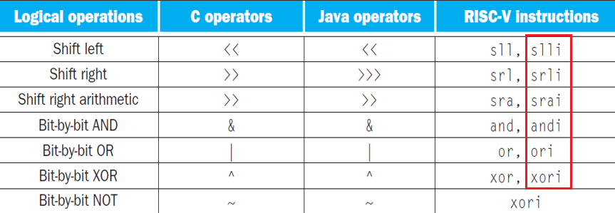
逻辑操作
逻辑左移=算数左移，右边统一添0
逻辑右移，左边统一添0
算数右移，左边添加的数和符号有关
左移结果出错，右移精度下降
注意RISC-V里面没有NOT指令，用（xor）取代 not
xori x10,x10,-1 // == NOT x10

Slide 12
存取操作
Load byte/halfword/word: Sign extend to 64 bits in rd
lb rd, offset(rs1)
lh rd, offset(rs1)
lw rd, offset(rs1)
Load byte/halfword/word unsigned: Zero extend to 64 bits in rd
Lb/h/wu rd, offset(rs1)
Store byte/halfword/word: Store rightmost 8/16/32 bits
Sb/h/w rs2, offset(rs1) 把rs2的低位存入rs1+offset
Notes:
Lb从内存中读出一个字节，放在寄存器的最右边8位。Sb同样。

Slide 13
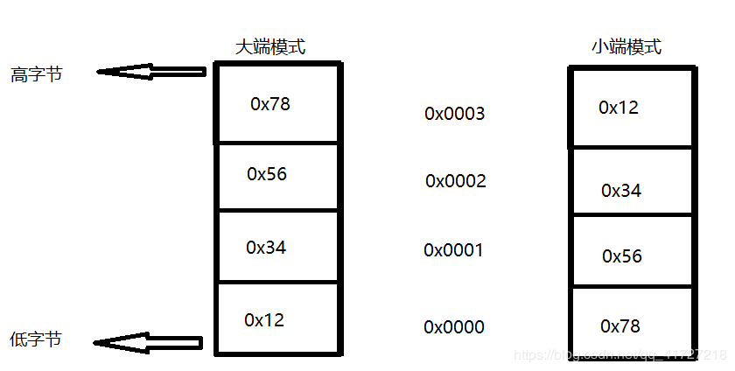
Endianness/byte order
便于阅读
便于处理
Big endian 大端模式：
数据的高字节存放在低地址；
数据的低字节存放在高地址
Little endian小端模式(主流：
数据的高字节存放在高地址；
数据的低字节存放在低地址
RISC-V
E.g. : 32位机器上存放0x12345678，其大小端模式存储如下：
最低有效位
Notes:
目前应该little endian是主流，因为在数据类型转换的时候（尤其是指针转换）不用考虑地址问题。

Slide 14
Memory Alignment（要整数倍放）
struct {
int a;
char b;
char c[2];
char d[3]
float e;
}
正确
e
Unused | D[2] | D[1] | D[0]
Unused | Unused | C[1] | C[0]
Unused | Unused | Unused | b
a
错误
错误
因为内存一次只能读出4字节内存中的一行
这样布局，e变量不能一次读出
虽然浪费了一点空间
Unused | e
e | D[2] | D[1] | D[0]

Slide 15
比较操作
slt Set when less than 寄存器与寄存器，前小于后1。 用于产生1
slti Set when less than immediate
sltu Set when less than
sltiu Set when less than immediate
Register x2 1111 1111 1111 1111 1111 1111 1111 1111
Register x3 0000 0000 0000 0000 0000 0000 0000 0001
slt x1, x2, x3 x1 = 1 (-1 < 1)
sltu x1, x2, x3 x1 = 0 (4,294,967,295ten > 1ten)

Slide 16
将有符号数当作无符号数处理，给我们提供了一种低成本的方式检查是否0<=x<y，常用于检查数组下标是否越界。 无符号数比较x<y，在检测x<y的同时，也检测了x是否为负数。
If (x20>=x11 or x20<0) goto IndexOutofBounds
RISC-V version:
bgeu x20, x11, IndexOutofBounds
RISC-V version （用比较替代):
sltu x1, x20, x11 x20 < x11
beq x1, x0, IndexOutofBounds

Slide 17
跳转操作
Unsigned comparison: bltu, bgeu
Example
x22 = 1111 1111 1111 1111 1111 1111 1111 1111
x23 = 0000 0000 0000 0000 0000 0000 0000 0001
x22 < x23 // signed
–1 < +1
x22 > x23 // unsigned
+4,294,967,295 > +1
bgt rs1, rs2, L1
if (rs1 > rs2) goto L1
blt rs2, rs1, L1
ble rs1, rs2, L1
if (rs1 <= rs2) goto L1
bge rs2, rs1, L1
jal x1, eLabel
Address of following instruction put in x1
Jumps to target address
jalr x0, 0(x1)
jumps to 0 + address in x1
Use x0 as rd (x0 cannot be changed
Notes:
无条件跳转： jal x1, Label，因为x1硬连线到0，效果等同于丢弃返回地址

Slide 18
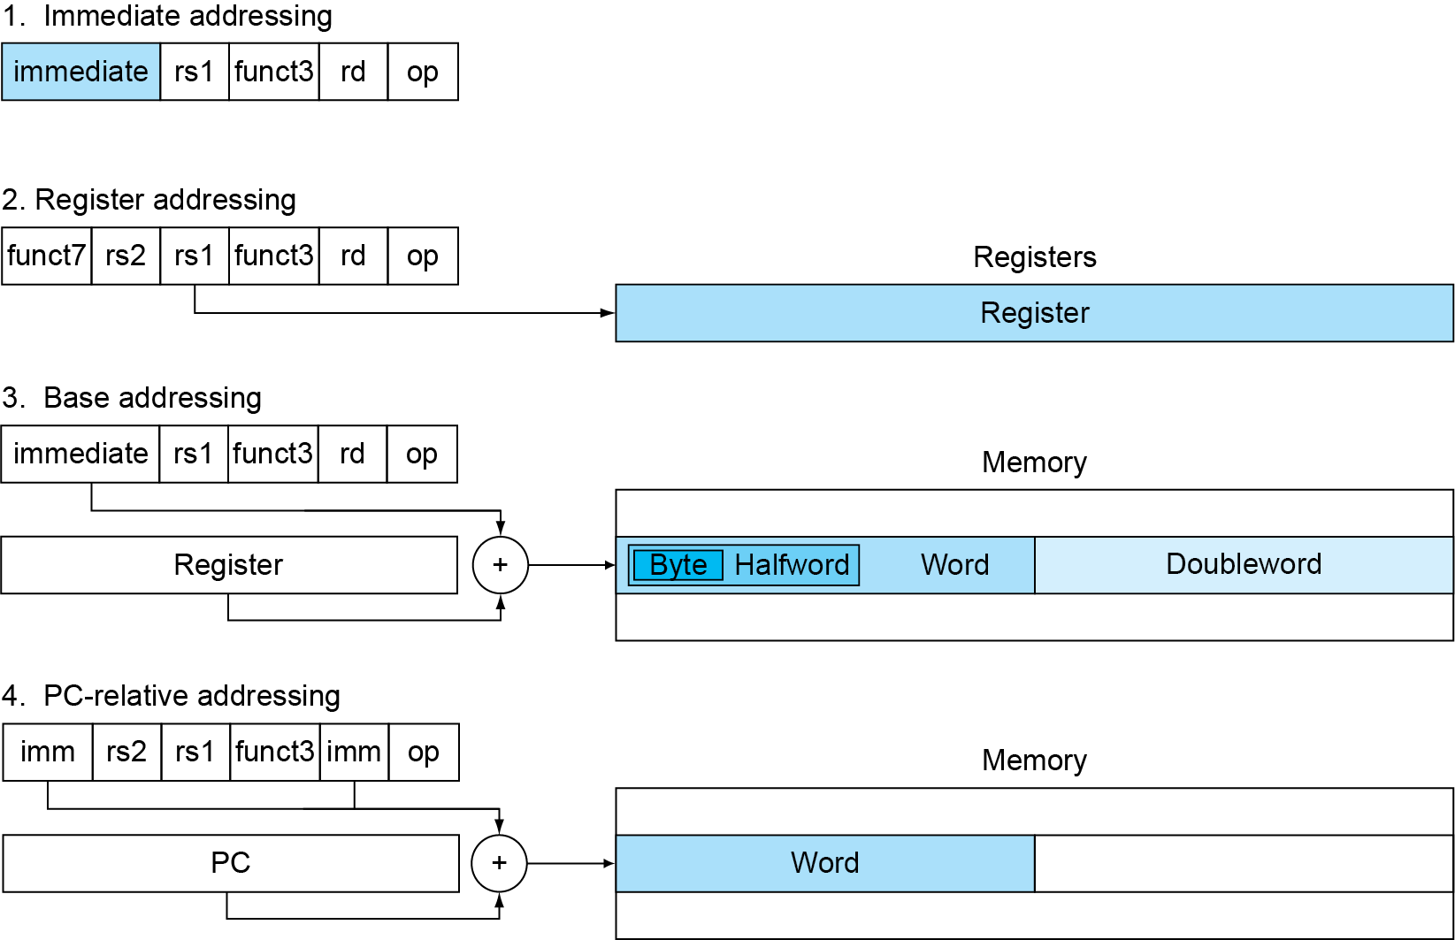
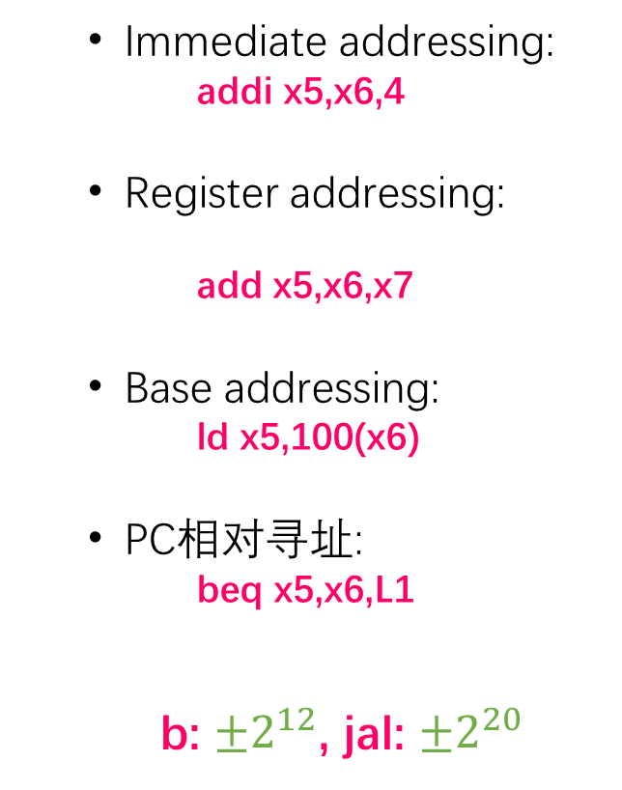
寻址
Immediate addressing:
addi x5,x6,4
Register addressing:
add x5,x6,x7
Base addressing:
ld x5,100(x6)
PC相对寻址:
beq x5,x6,L1
b: $±2^{12}$, jal: $±2^{20}$
Notes:
立即数寻址：操作数是指令本身的常量
寄存器寻址：操作数在寄存器中
基址寻址：操作数在内存中，其地址是寄存器和指令中的常量（字节）之和
他设定就是这样因为一条指令宽度不是1，所以你跳1没用，所以就乘2了

Slide 19
Case/Switch
Example
Compiling a switch using jump address table
( Assume: f ~ k ---- x20 ~ x25 x5 contains 4 )
C code:
switch ( k ) {
case 0 : f = i + j ; break ; /* k = 0 */
case 1 : f = g + h ; break ; /* k = 1 */
case 2 : f = g - h ; break ; /* k = 2 */
case 3 : f = i - j ; break ; /* k = 3 */
}

Slide 20
构建转移地址表
RISC-V assembly code:
bgeu x25, x5, Exit // if k >= 4 或者 k < 0, go to Exit
slli x7, x25, 3 // temp reg x7 = 8 * k
add x7, x7, x6 // x7 = address of JumpTable[k]
ld x7, 0(x7) // x7 gets JumpTable[k]
jalr x1, 0(x7) // jump entrance
Exit:
jump address table
L0: add x20, x23, x24 // k = 0 so f gets i + j
jalr x0, 0(x1) // end of this case so go to Exit
L1: add x20, x21, x22 // k = 1 so f gets g + h
jalr x0, 0(x1) // end of this case so go to Exit
L2: sub x20, x21, x22 // k = 2 so f gets g - h
jalr x0, 0(x1) // end of this case so go to Exit
L3: sub x20, x23, x24 // k = 3 so f gets i - j
jalr x0, 0(x1) //end of switch statement
L0:address
L1:address
L2: address
L3:address

Slide 21
加载一个大数
| imm[31:12] | rd | opcode |
20bits 5 bits 7 bits
lui rd, constant
用于将20位常数加载到寄存器的第31位到第12位，低12位填充0
低12位addi或者ori放进去
lui x19, 976 // 0x003D0
31 12 | 11 7 | 6 0
0000 0000 0011 1101 0000 | 10011 | 011 0111
Instruction
Filling zero
Register
0000 0000 0011 1101 0000 | 00000 | 0000000
Notes:
用addi, 把16位立即数按照有符号数拓展，所以最高位是0没有问题，最高位是1就不对了，用ori 没有这个问题, 或者先用lui 在第12位添加1，然后再用addi加上低16位。

Slide 22
2 Translation using Register

Slide 23
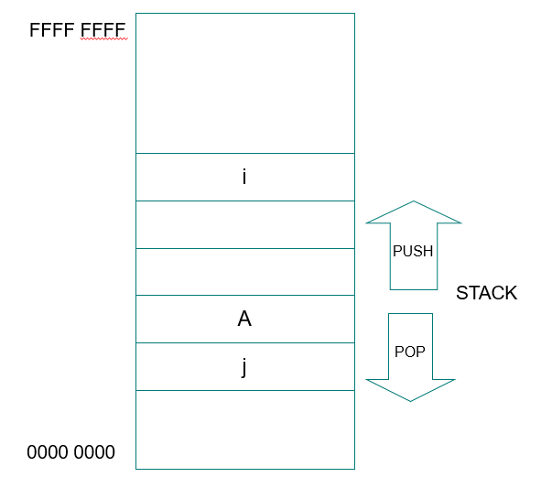
Using More Registers
Registers for procedure calling
x10~ x17: 8 argument registers to pass parameters or return values
x1: 返回地址
Stack：用栈来完成spilling registers
Push, pop
Stack pointer (sp)栈指针: x2
x0:0
SP 指明栈顶位置
Push: sp= sp-8
Pop: sp = sp+8
栈底
Notes:
寄存器是保存数据最快的存储位置，在过程调用的时候尽量多的使用寄存器，
如果一个过程需要多于8个参数寄存器，就需要换出寄存器到存储器。并且在过程完成后，所用的寄存器必须恢复到调用之前的值。
最理想的数据结构就是栈—后进先出队列。把数据放入栈叫push，移除数据称为出栈,pop，栈指针，一个特殊的寄存器，sp（x2)，用于保存被调用者所需的寄存器。栈是内存里的一块存储结构，栈底是高地址，栈增长是地址从高到低，push的时候，sp减小，pop, sp增大

Slide 24
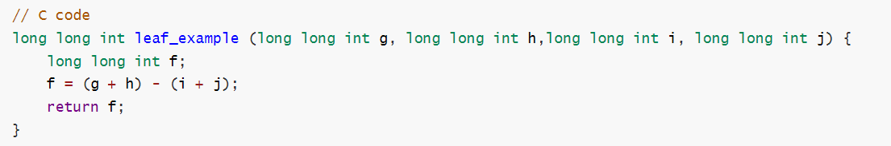
Leaf Procedure Example
Arguments g, …, j in x10, …, x13
f in x20
temporaries x5, x6
Need to save x5, x6, x20 on stack
Notes:
在32位的系统中： `short`与`int`占两个字节， `long` 占四个字节， `long long` 占八个字节； 在64位的系统中： `short`占两个字节， `int` 与 `long` 占四个字节， `long long` 占八个字节。
4个参数所在的寄存器不用保存，过程体还需要两个临时寄存器，因此，需要保存3给寄存器，首先是保存过程中使用的寄存器

Slide 25
RISC-V code:
addi sp,sp,-24
sd x5,16(sp)
sd x6,8(sp)
sd x20,0(sp)
add x5,x10,x11
add x6,x12,x1
sub x20,x5,x6
addi x10,x20,0
ld x20,0(sp)
ld x6,8(sp)
ld x5,16(sp)
addi sp,sp,24
jalr x0,0(x1)
// Save x5, x6, x20 on stack
// x5 = g + h
// x6 = i + j
// f = x5 – x6
// copy f to return register
// Restore x5, x6, x20 from stack
Return to caller
Notes:
x10：返回值

Slide 26
Non-Leaf Procedures
Procedures that call other procedures
For nested call, caller调用者（父函数） needs to save on the stack:
Its return address
Any arguments and temporaries needed after the call
Restore from the stack after the call
Caller save： return address
arguments
important temporaries(t registers) that will be used after call
Callee save被调用者： any S registers used for local variables
Notes:
没有调用其他过程的过程叫做叶过程。实际上，很多时候过程还要调用其他过程。更进一步，过程调用自身，这就是递归。过程调用时，必须小心保存寄存器，一个解决方法是将其他所有必须保存的寄存器压栈，我们规定调用者将所有调用后还需要的参数寄存器（x10-x17）或临时寄存器（x5~x7, x28~x31）压栈。被调用者将返回地址寄存器（x1）和被调用者使用的保存寄存器（x8,x9,x18~x27）压栈。

Slide 27
Six steps of Function执行函数
将参数放置于过程能够访问的位置（寄存器x10至x17）
转移控制权至过程
获取过程所需的存储资源，保存调用者保护的寄存器
执行所需的任务
将结果值放置于调用程序能够访问的地方。释放资源。恢复保存的寄存器
将控制权返回至起始点（x1中的地址可能不同，应每次都进行保存）

Slide 28
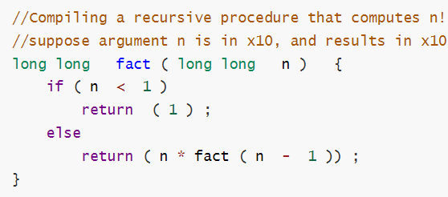
Nested Procedure
RISC-V assembly code
fact: addi sp, sp, -16 // adjust stack for 2 items
sd x1, 8(sp) // save the return address
sd x10, 0(sp) // save the argument n
addi x5, x10, -1 // x5 = n - 1
bge x5, x0, L1 // if n >= 1, go to L1(else)
addi x10, x0, 1 // return 1 if n <1
addi sp, sp, 16 // Recover sp (Why not recover x1and x10 ?)
jalr x0, 0(x1) // return to caller
Notes:
X10存储了n， X1存了返回的地址
从栈中弹出两项之前，我们本应该载入x1和x10, 因为n<=1时，它们都没有发生变化，所有就跳过这两条指令。
无ld x1, ld x10因为没有值没有变
但是递归效率不高，伪码=递归可以用for循环代替

Slide 29
L1: addi x10, x10, -1 // n >= 1: argument gets ( n - 1 ) 返回n！
jal x1, fact // call fact with ( n - 1 )
add x6, x10, x0
ld x10, 0(sp) // 存的值n 变了
ld x1, 8(sp) // 返回地址 变了
addi sp, sp, 16 // adjust stack pointer to pop 2 items修改栈顶
mul x10, x10, x6 // return n*fact ( n - 1 )
jalr x0, 0(x1) // return to the caller
Preserved things across a procedure call
Saved registers, stack pointer register( sp ),
return address register( x1 ), stack above the stack pointer
Not preserved things across a procedure call
Temporary registers, argument registers( x10 ~ x17),
return value registers ( x10 ~ x17), stack below the stack pointer
Notes:
下面是n>1的情况，n=n-1, 再次调用fact。因为再次调用fact的时候，x1和x10的值变了，当fact执行完返回时，我们需要把原先的参数和返回地址取出来。

Slide 30
RISC-V register conventions
RISC-V约定在“x”后面跟一个编号来表示寄存器
Name | Register name | Usage | Preserved On call?
x0 | 0 | The constant value 0 | n.a.
x1(ra) | 1 | Return address返回地址 (ra) | yes
x2(sp) | 2 | Stack pointer 栈指针 (sp) | yes
x3(gp) | 3 | Global pointer (gp) | yes
x4(tp) | 4 | Thread pointer (tp) | yes
x5-x7 | 5-7 | Temporaries (t0~t2) | no
x8-x9 | 8-9 | Saved (s0~s1) | yes
x10-x17 | 10-17 | Arguments/results (a0~a7) | no
x18-x27 | 18-27 | Saved (s2~s11) | yes
x28-x31 | 28-31 | Temporaries (t3~t6) | no
Notes:
如果参数超过8个怎么办？RISC-V约定将栈中额外的参数放在帧指针的上方。可以通过帧指针寻址。帧指针的方便性在于对过程中栈内变量的所有引用都具有相同的偏移。但是，帧指针不是必需的。RISC-V编译器仅在改变了栈指针的过程中使用帧指针。
Temporaries调用的时候不用压栈。Saved需要压栈出栈

Slide 31
RISC-V operands
Name | Example | Comments
32 registers | x0-x31 | Fast locations for data. In RISC-V, data must be in registers to perform arithmetic. Register x0 always equals 0.
2⁶¹ memory words（64位数据） | Memory[0], Memory[8] , …… , Memory[18446744073709551608] | 只能通过数据传输指令访问。RISC-V使用字节地址，因此顺序双字访问相差8。内存保存数据结构、数组和溢出寄存器。
Memory[0] 和 Memory[1] 差一个byte， 4 byte=1 word

Slide 32
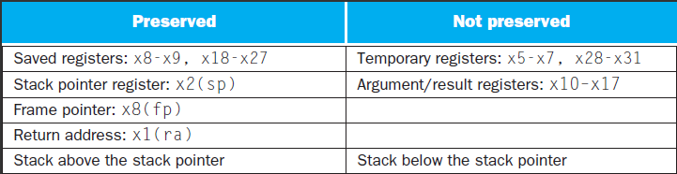
x5 – x7, x28 – x31: temporary registers
Not preserved by the callee
x8 – x9, x18 – x27: saved registers
If used, the callee saves and restores them
Notes:
有些方案也保存了栈，以确保调用者在弹栈时取回与压栈时相同的数据。Sp以上的栈通过确保被调用者不在其上进行写入来保存；sp本身就是由被调用者将其被减去的值重新加上来保存的，并且其他寄存器通过将它们保存到栈（若被使用）并从栈中将其恢复来进行保存。

Slide 33
例题

Slide 34
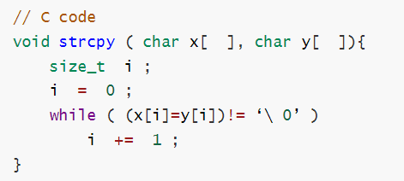
String Copy Example
( Assume: i -- x19， x’s base --x10, y’s base ----x11)
RISC-V assembly code:
strcpy: addi sp, sp, -8 // adjust stack for 1 doubleword
sd x19, 0(sp) // save x19
add x19, x0, x0 // i = 0
L1: add x5, x19, x11 // address of y[ i ] in x5
lbu x6, 0(x5) // x6 = y [ i ]
add x7, x19, x10 // address of x[ i ] in x7
sb x6, 0(x7) // x[ i ] = y[ i ]
beq x6, x0, L2 // if y[ i ] == 0, go to L2
addi x19, x19, 1 // i = i + 1
jal x0, L1 // go to L1
L2: ld x19, 0(sp) // restore x19
addi sp, sp, 8 // pop 1 doubleword off stack
jalr x0, 0(x1) // return
Notes:
本质就是数组访问
注意到 y和x 都是一个byte 数组，所以不需要乘8
不用x19，换一个可以不压栈出栈减少时间消耗

Slide 35
translating C procedures
Allocate registers to program variables分配
Produce code for the body of the procedures传参
Preserve registers across the procedures invocation保存
Procedure swap
C code
void swap ( long long v[ ] , size_t k )
{
long lon temp ;
temp = v[ k ] ;
v[ k ] = v[ k + 1 ] ;
v[ k + 1 ] = temp ;
}
Notes:
排序是一个经典例子
主要是为了讲解在循环过程当中是怎么编译的汇编语言，特别是在循环中调用其他函数

Slide 36
Register allocation for swap
v ---- x10 k ---- x11 temp ---- x5
swap is a leaf procedure, nothing to preserve
RISC-V code for the procedure swap
Procedure body
swap: slli x6, x11, 3 // x6 = k * 8
add x6, x10, x6 // x6 = v + ( k * 8 )
ld x5, 0(x6) // x5 ← v[ k ]
ld x7, 8(x6) // x7 ← v[ k + 1 ]
sd x7, 0(x6) // v[k+1] → v[ k ]
sd x5, 8(x6) // v[k] → v[ k + 1 ]
Procedure return
jalr x0, 0(x1) //把返回地址压栈

Slide 37
Procedure sort
C code
void sort (long long v[ ] , size_t n )
{
size_t i , j ;
for ( i = 0 ; i < n ; i + = 1 ) {
for ( j = i - 1 ; j >= 0 && v[j] > v[j+1] ; j -= 1 )
swap ( v , j ) ;
}
}
Register allocation for sort
v ---- x10 n ---- x11 i ---- x19 j ---- x20
Passing parameters in sort
Preserving registers in sort
x1 , x19, x20, x21, x22
If V[0]> V[1]
V[0]
V[1]
V[2]
……
V[n-1]

Slide 38
RISC V Code for the procedure sort
Saving registers压栈
sort: addi sp, sp, -40 // make room on stack for 5 registers
sd x1, 32(sp) // save return address on stack
sd x22, 24(sp) // save x22 on stack
sd x21, 16(sp) // save x21 on stack
sd x20, 8(sp) // save x20 on stack
sd x19, 0(sp) // save x19 on stack
Procedure body{Outer loop {Inner loop} }
Restoring registers出栈
exit1: ld x19, 0(sp) // restore x19 from stack
ld x20, 8(sp) // restore x20 from stack
ld x21, 16(sp) // restore x21 from stack
ld x22, 24(sp) // restore x22 from stack
ld x1, 32(sp) // restore return address from stack
addi sp, sp, 40 // restore stack pointer
Procedure return跳转到返回地址
jalr x0, 0(x0) // return to calling routine

Slide 39
Code for Procedure body
Outer loop—first for loop
for ( i = 0 ; i < n ; i + = 1 ) {
Move parameters
mv x21, x10 // copy parameter x10 into x21
mv x22, x11 // copy parameter x11 into x22
Outer loop
li x19, 0 // i = 0
for1tst: bge x19, x22, exit1 // go to exit1 if i >= n
………………
（body of first for loop is second for loop）
………………
exit2: addi x19, x19, 1 # i = i + 1
j for1tst # jump to test of outer loop
exit1:
存起来，因为后续swap( , )还需要用到
初始化为0
连接到出栈返回

Slide 40
Inner loop-- second for loop is body of first for loop
for ( j = i - 1 ; j >= 0 && v[j] > v[j+1] ; j- = 1 ){
addi x20, x19, -1 // j = i - 1
for2tst: blt x20, x0, exit2 // go to exit2 if j < 0
slli x5, x20, 3 // x5 = j * 8
add x5, x21, x5 // x5 = the address of v[j]
ld x6, 0(x5) // x6 = v[j]
ld x7, 8(x5) // x7 = v[j + 1]
blt x6, x7, exit2 // go to exit2 if v[j] < v[j+1]
………………
（body of first for loop ）
………………
addi x20, x20, -1 // j = j - 1
j for2tst // jump to test of inner loop
exit2:

Slide 41
body of first for loop
Pass parameters and call
mv x10，x21 // first swap parameter v
mv x11，x20 // second swap parameter j
Call function swap
jal x1, swap
Notice: 1.Why are x10 and x11 saved? x10 is the base of the array v. x10 will be used repeatedly and might be(actually not here) changed by the procedure swap. x11 is the size of the array v. x11 will be used repeatedly and changed before the procedure swap is called.
2.Why are they not pushed to stack?
Register variable is faster

Slide 42
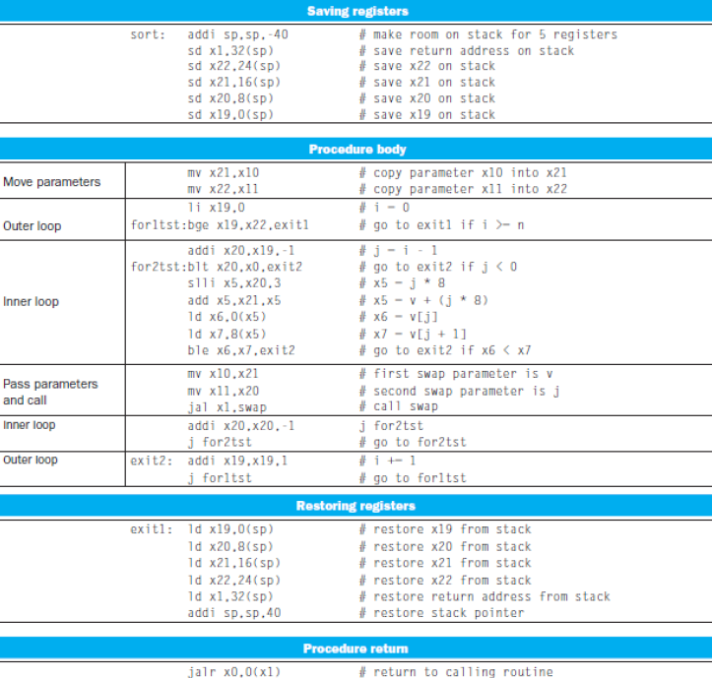
Notes:
以上的整个过程，记得压栈出栈（可以先用temprorary的，用光了再用saved）
父函数保证：子函数能随便使用temporary registers (x5-x7, x28-x31)，返回给父函数的时候，x5-x7, x28-x31的值可以被改变。
子函数保证：返回给父函数的时候，saved registers(x18-x27) 保持父函数调用子函数前的值

Slide 43
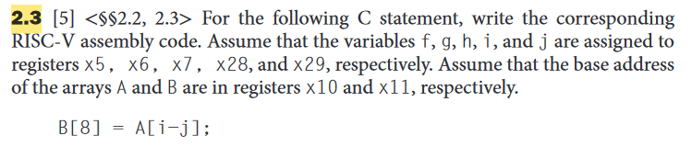
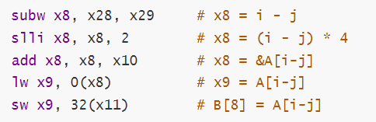

Slide 44
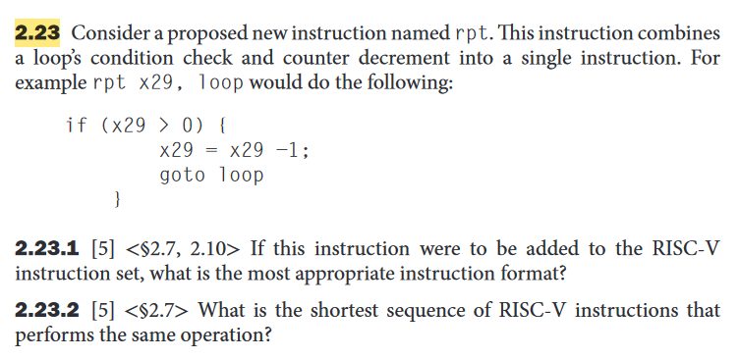
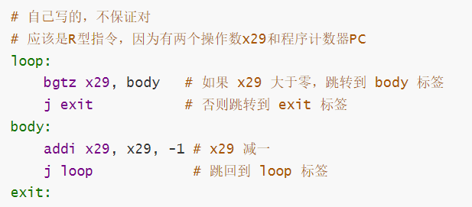
应该写为jal x0 loop
j 直接跳转

Slide 45
